Slide 1
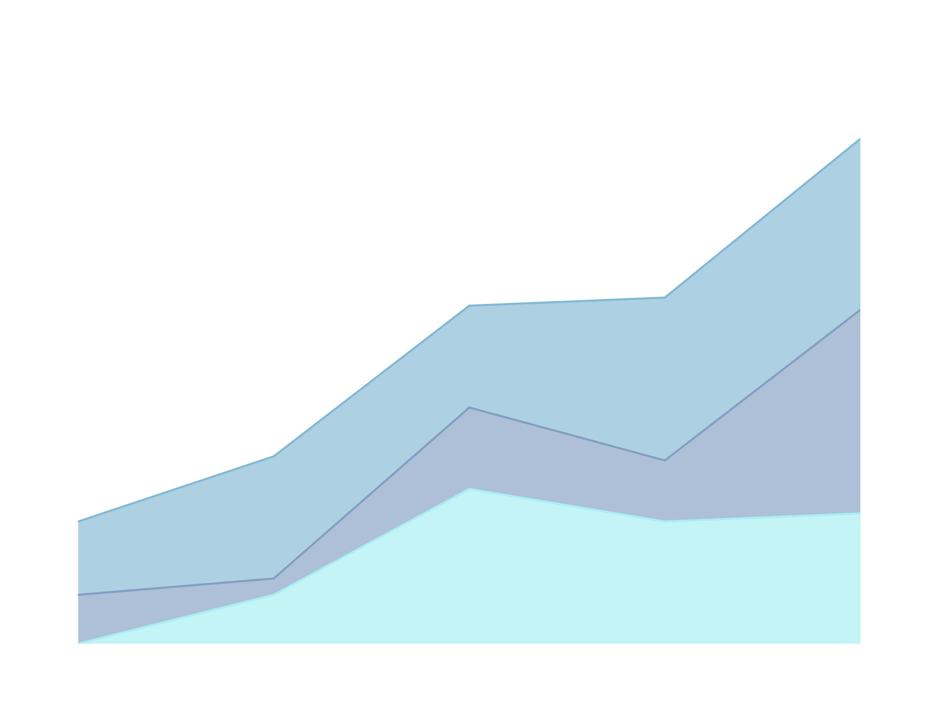
FDDB
ANGELINA DELA CRUZ, TIMOTHY HO, CHUA ZIYING
TEAM 8
SC1015 PROJECT

Slide 2
DIABETES
ranks among the top 10 leading causes of death in adults (Saeedi et al., 2019)

Slide 3
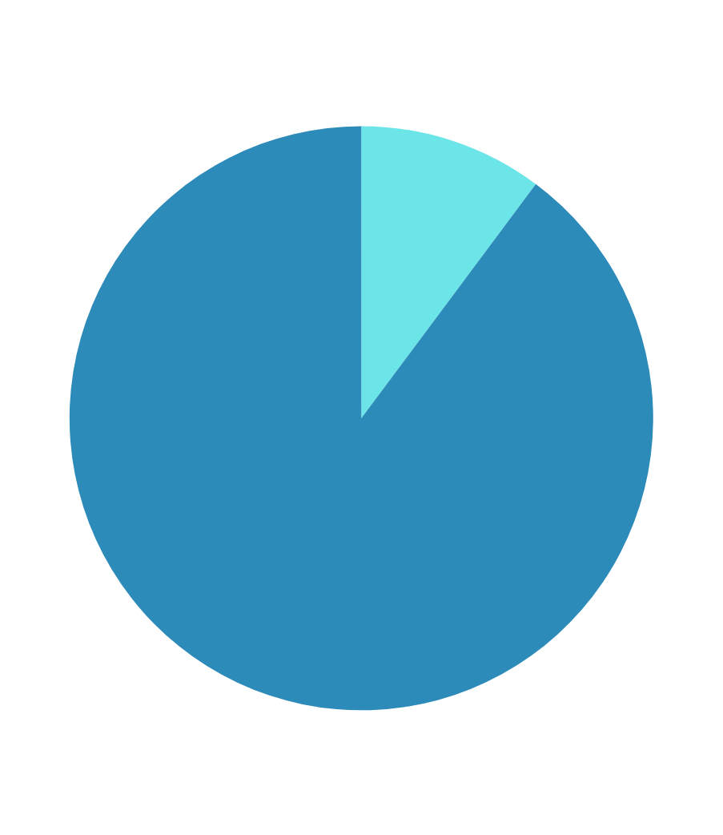
GLOBAL ADULT POPULATION
DIABETES
ranks among the top 10 leading causes of death in adults (Saeedi et al., 2019)
by 2030, approximately 10.2% of the global adult population will be affected by diabetes (Saeedi et al., 2019)

Slide 4
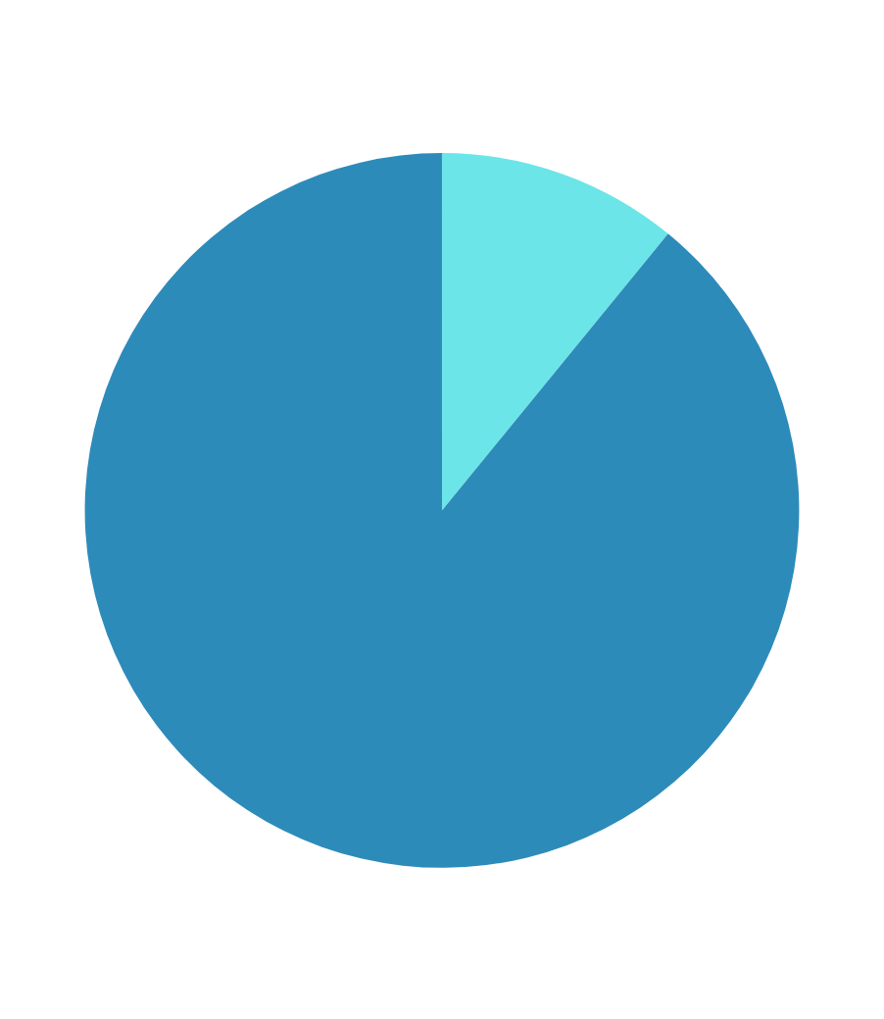
GLOBAL ADULT POPULATION
DIABETES
ranks among the top 10 leading causes of death in adults (Saeedi et al., 2019)
by 2030, approximately 10.2% of the global adult population will be affected by diabetes (Saeedi et al., 2019)
this figure is expected to rise to 10.9% by 2045 (Saeedi et al., 2019)

Slide 5
PROBLEM DEFINITION
To utilise machine learning methods to forecast the causal factors contributing to the rise in diabetes prevalence.

Slide 6


INDIVIDUALS
HEALTH PROFESSIONALS
GOVERNMENT

Slide 7

Data Collection & Cleaning

Slide 8

DATA COLLECTION
From Centers for Disease Control and Prevention (CDC), we used the Behavioral Risk Factor Surveillance System (BRFSS) Annual Data from 2020.

Slide 9
Gender
Age
Amount of Sleep
Tobacco Use
Alcohol Consumption
Health Care Access
Heart Disease/Heart Attack
Martial Status
Amount of Exercise
BMI
Level of Education
Annual Income
Last Checkup
Cost Barrier to doctor
Diabetes
From the survey data:

Slide 10
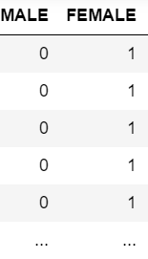

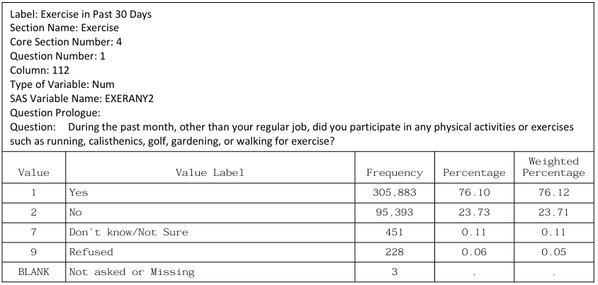
DATA CLEANING
Remove all null values
One-hot encoding on non-ordinal variables
Combine wanted variables into a dataframe
Remove irrelevant values and renumbering
Rename variables for clarity
'_AGEG5YR': 'AGE_RANGE',
'EXERANY2': 'EXERCISE',
'ALCDAY5': 'ALC_MONTH',
'_BMI5CAT': 'BMI_CAT',
'INCOME2': 'ANNUAL_INCOME',
'SLEPTIM1': 'AV_SLEEP',
'EDUCA': 'HIGHEST_EDU',
'MEDCOST' : 'COST_BARRIER',
'POORHLTH': 'POOR_HEALTH',
'DIABETE4': 'DIABETES',
'SMOKEEVERYDAY' : 'SMOKE_EVERYDAY',
'SMOKESOMEDAYS' :'SMOKE_SOMEDAYS',
'DONOTSMOKE': 'DO_NOT_SMOKE',
'CVDCRHD4': 'HEART_DISEASE',
'CVDINFR4': 'HEART_ATTACK',
'CHECKUP1' : 'LAST_CHECKUP'

Slide 11
Exploratory Data Analysis

Slide 12
INDEPENDENT VARIABLES
DEPENDENT VARIABLE
Variable Type | Correlation measurement
Ordinal | Rank-Biserial Correlation
Continuous | Point-Biserial Correlation
Dichotomous | Phi coefficient
DIABETES
dichotomous variable

Slide 13
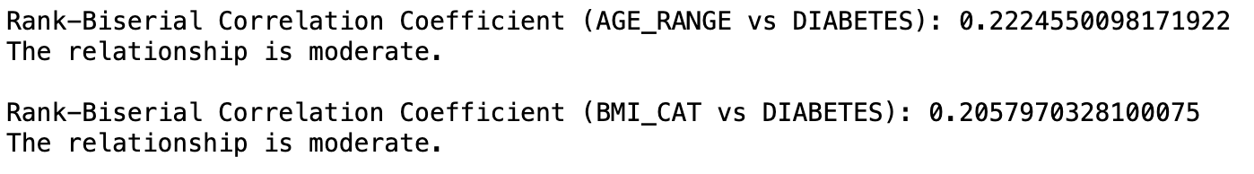
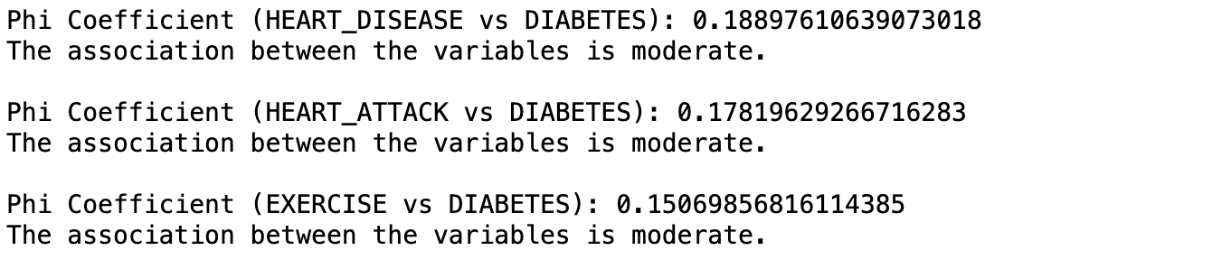
CORRELATION MEAUREMENT RESULTS

Slide 14
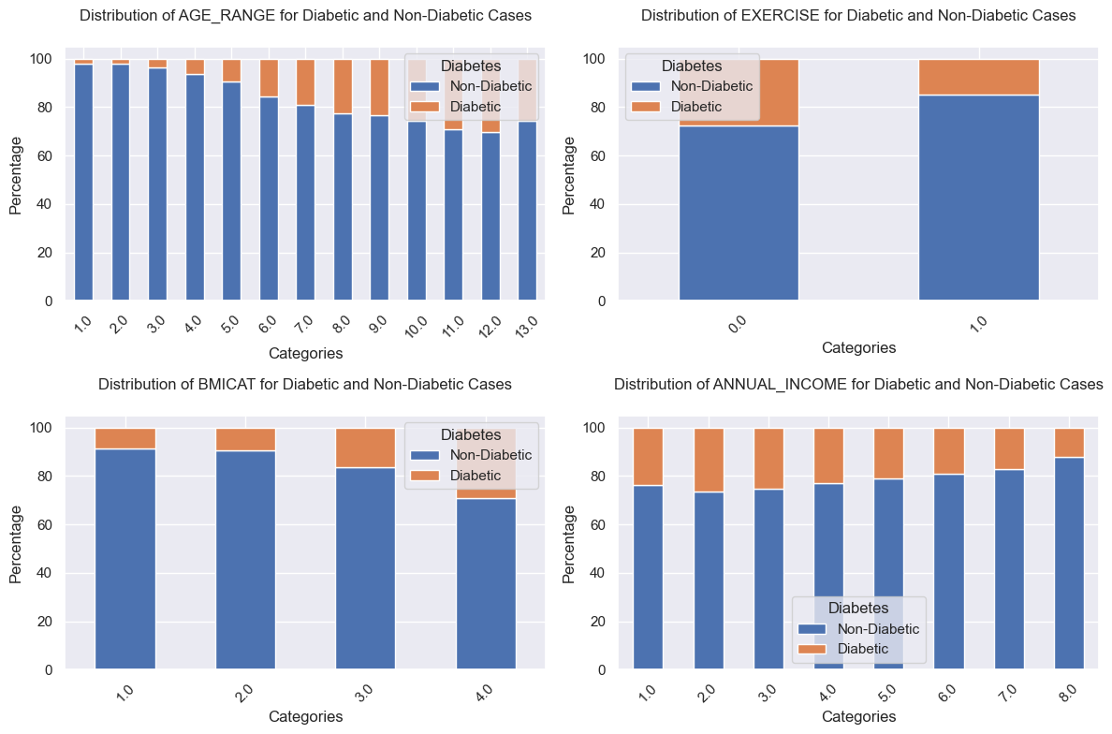

Slide 15
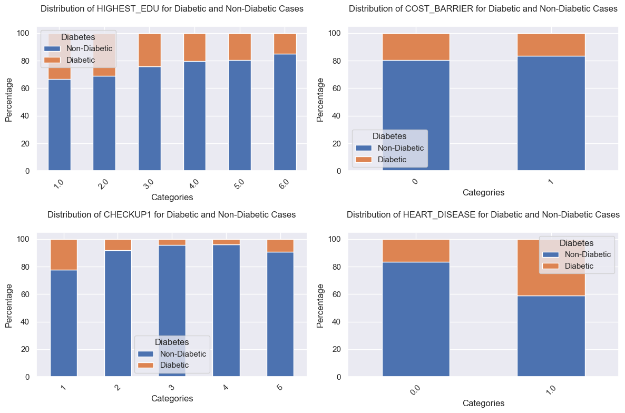

Slide 16
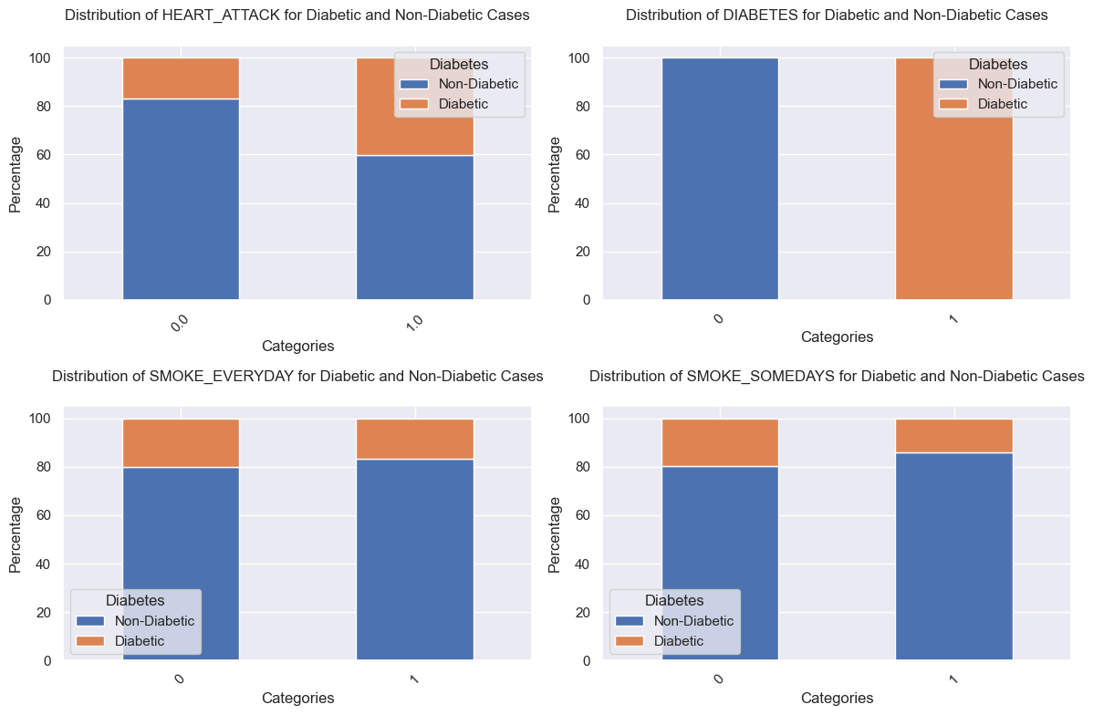
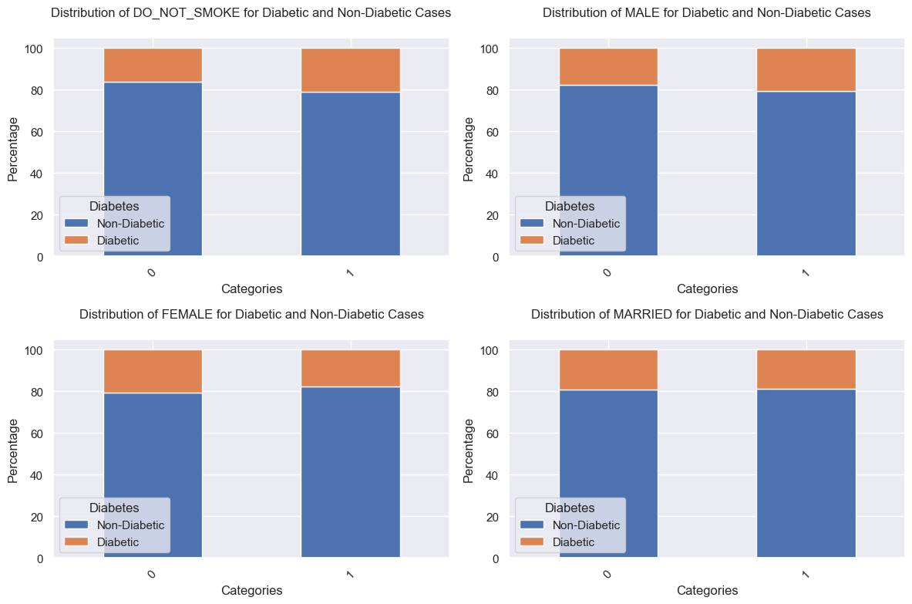

Slide 18
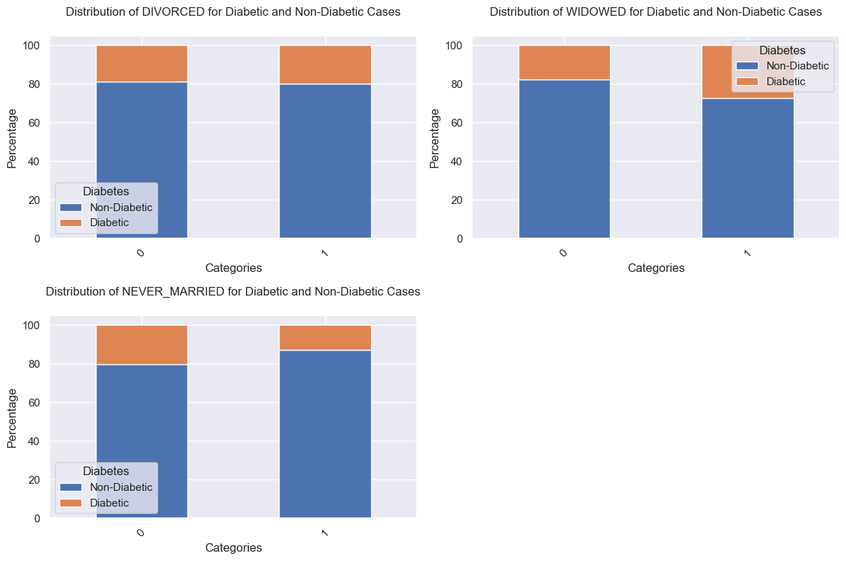

Slide 19
Keep | Remove
AGE_RANGE BMI_CAT ANNUAL_INCOME HIGHEST_EDU HEART_DISEASE HEART_ATTACK EXERCISE | ALC_MONTH AV_SLEEP COST_BARRIER POOR_HEALTH SMOKEEVERYDAY SMOKESOMEDAYS DONOTSMOKE MALE FEMALE MARRIED DIVORCED WIDOWED NEVER_MARRIED
7 VARIABLES REMAIN

Slide 20
Machine Learning Models

Slide 21
MACHINE LEARNING MODELS
Random Forest
Support Vector Machine
Logistic Regression

Slide 22
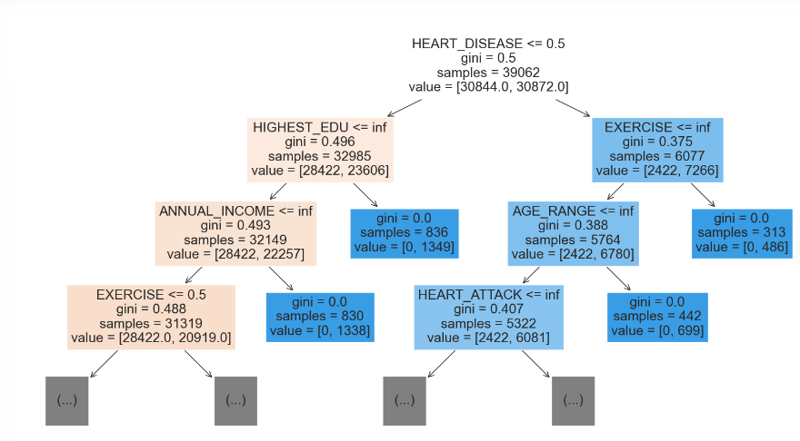
RANDOM FOREST

Slide 23
iterative process:
explores a wide range of values
evaluates the model's performance
narrows down the range based on the results to focus on promising values
RANDOM FOREST
GridSearch to tune the random forest classifier’s hyperparameters

Slide 24
ACCURACY
general indication of how often the model's predictions are correct
F1 SCORE
measure of a model's accuracy that considers both the precision and the recall
AUC SCORE
represents the model's ability to distinguish between positive and negative classes
RANDOM FOREST
Performance evaluation using cross-validation

Slide 25
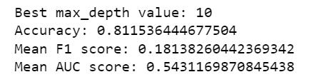
RESULTS
RANDOM FOREST
The Random Forest model is not performing well.
A probable reason is that our dataset is imbalanced.

Slide 26
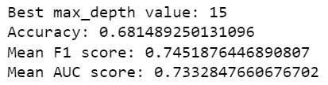
RANDOM FOREST
WITH
SMOTE
NEW RESULTS
Generates synthetic samples for the minority class to balance the class distribution
The Random Forest model is performing much better now.

Slide 27
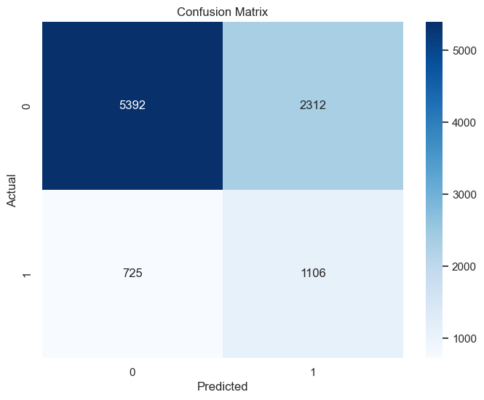
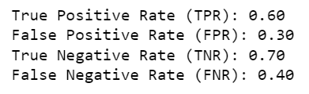
CONFUSION MATRIX
FOR RANDOM FOREST

Slide 28
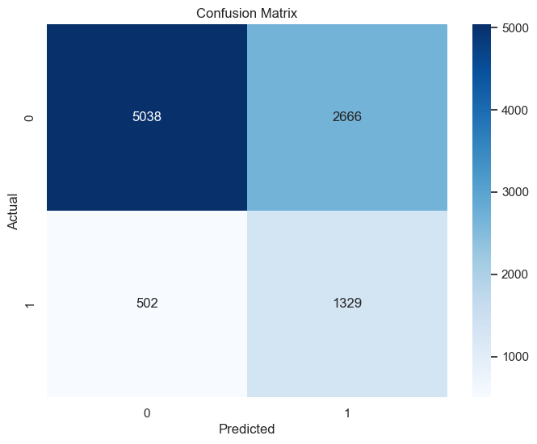

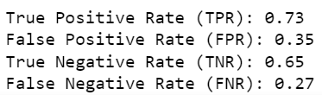
SUPPORT VECTOR MACHINE (SVM)
WITH SMOTE
Analyses and finds the optimal hyperplane that separates data points into different classes.

Slide 29

LOGISTIC REGRESSION
WITH SMOTE
Predicts how likely a certain instance belongs to a specific class.
Accuracy and Mean AUC of the logistic regression model is the highest
However, it also has an F1 score lower than that for Random Forest

Slide 30
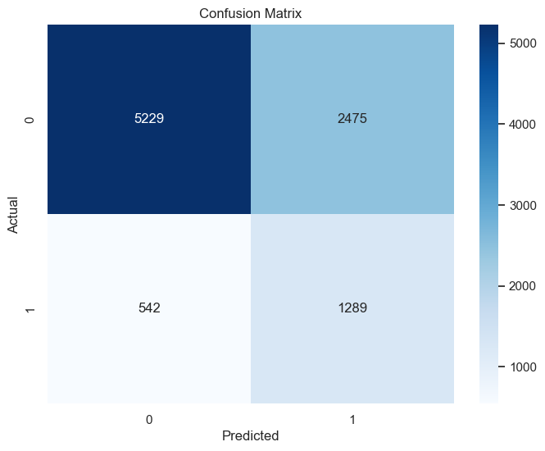
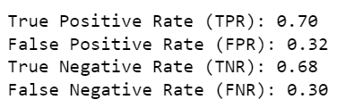
LOGISTIC REGRESSION
WITH SMOTE
Predicts how likely a certain instance belongs to a specific class.

Slide 31
robust to outliers
suitable for non-linear data
less prone to overfitting
performs efficiently on large datasets
often achieves higher accuracy as opposed to other classification algorithms
CONCLUSION
we recommend using random forest

Slide 32
Compared to Support Vector Machine (SVM) and Logistic Regression, random forest is shown to have high scores for both accuracy, mean F1 score and mean AUC score
 | Random forest | SVM | Logistic regression
Accuracy | 0.681 | 0.668 | 0.684
Mean F1 score | 0.745 | 0.456 | 0.464
Mean AUC score | 0.733 | 0.690 | 0.762

Slide 33

THANK YOU

